Slide 1
The Iranian Bakery scheduling problem
MB- Coursework Heuristics, 2024

Slide 2
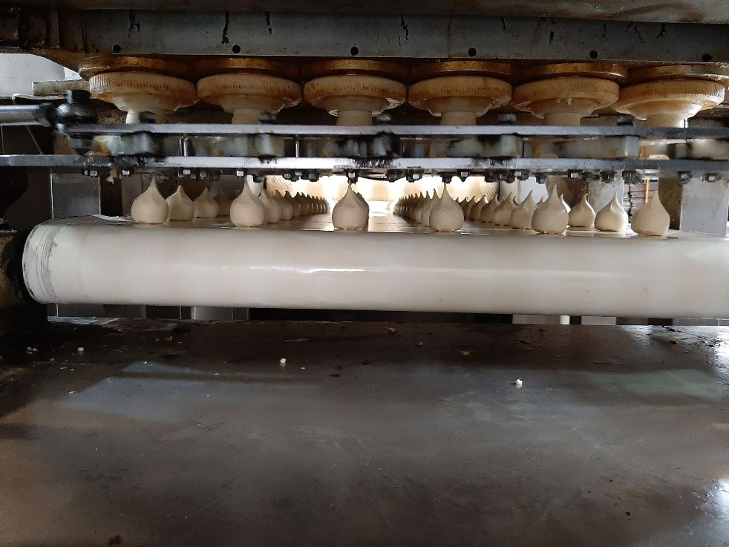
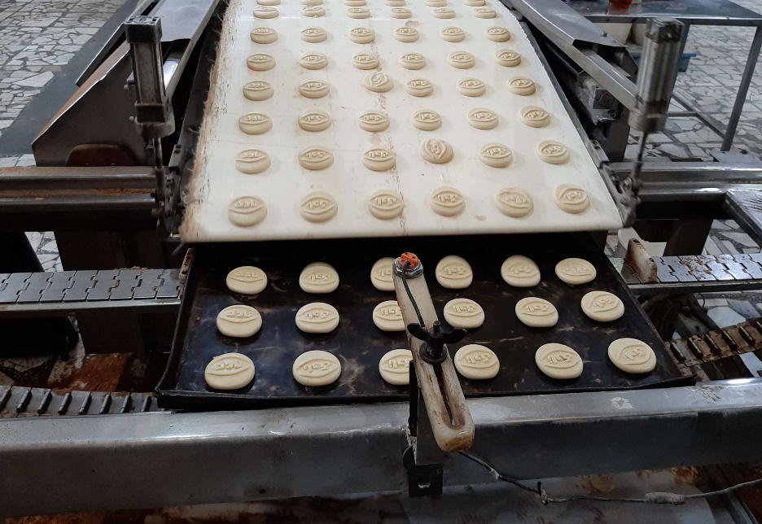
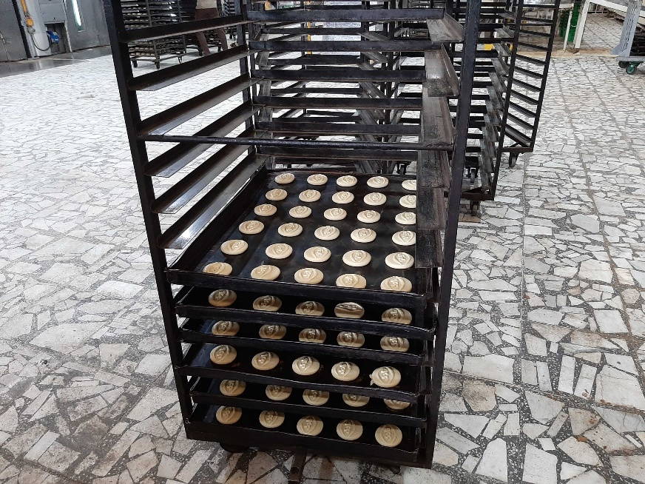
The bakery
The Iranian bakery produces, among others, a specialty biscuit that cooks for many hours at slow temperature. The biscuits have different shapes. Therefore, the cooking duration of biscuits might vary.

Slide 3
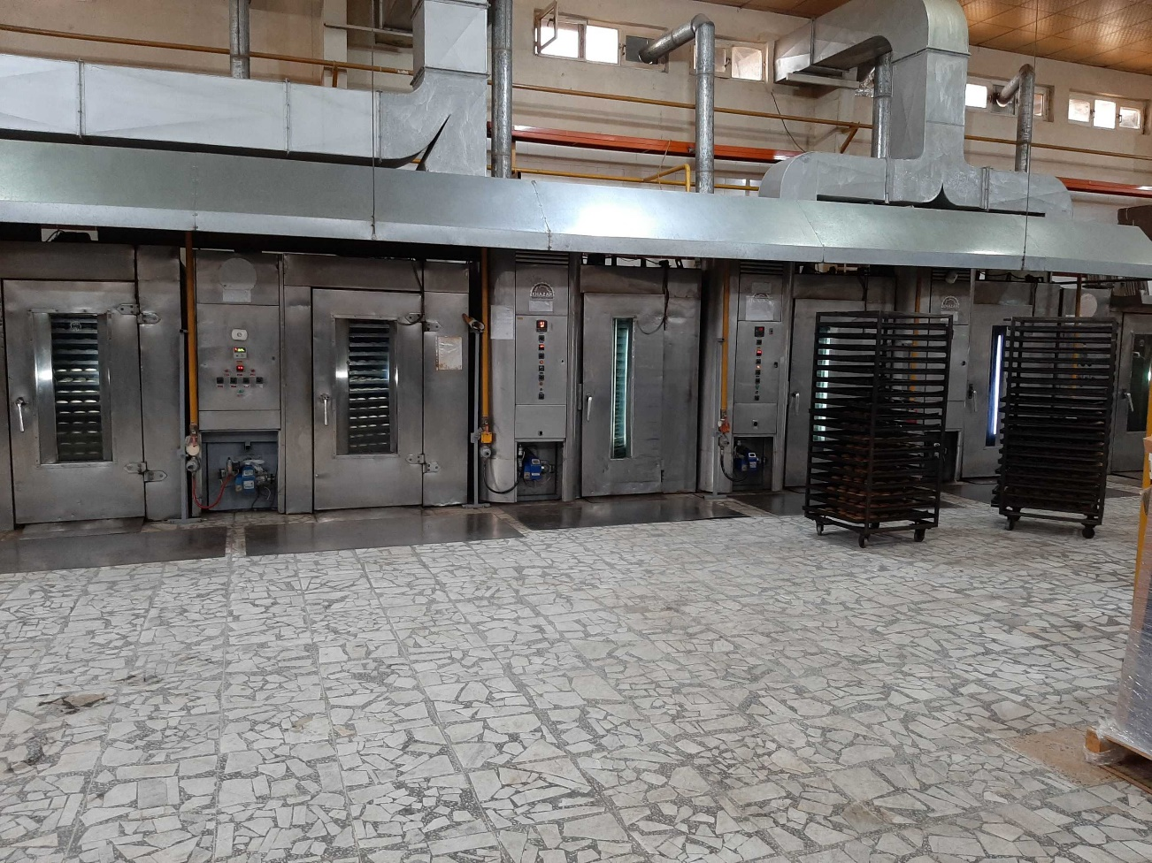
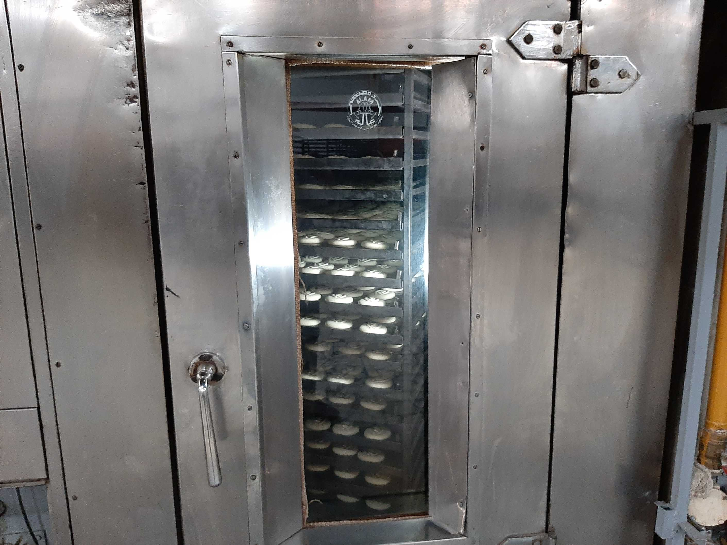
The bakery

Slide 4
The bakery
Trays with the same cooking duration are called hereafter a job. Each job t is associated with a cooking duration c_{t} and a space occupied in the oven s_{t} . The trays in a job have to be cooked in the same oven.
Each oven o has a capacity of S_{o}, so multiple jobs can be cooked simultaneously as long as the capacity of the oven is satisfied (the jobs cooking simultaneously in the same oven are called a batch). Note that an oven can cook more than a batch of biscuits in a day, but a new batch can start cooking only when all jobs in the previous batch are finished cooking.
Your goal is to schedule the baking of all jobs, so that time to complete the baking of the last job is minimized.. The literature refers to this objective as the makespan minimization.

Slide 5
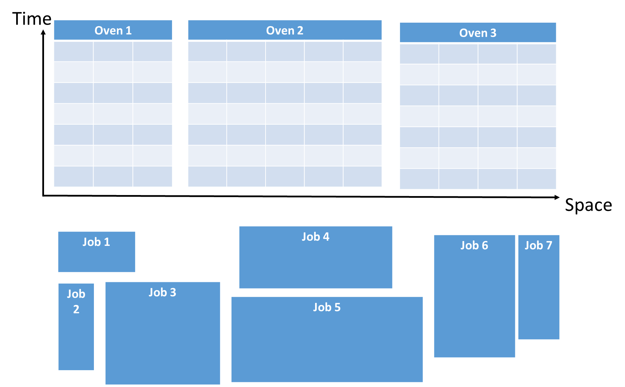
A problem instance
NumbOvens 3
NumJobs 7
OvenCapacity 3 5 4
TimeNecessaryforEachJob 2 4 5 3 4 6 5
SpaceOccupiedPerJob 2 1 3 4 5 2 1
See text files with same format for your benchmark set

Slide 6
A problem instance
NumbOvens 3
NumJobs 7
OvenCapacity 3 5 4
TimeNecessaryforEachJob 2 4 5 3 4 6 5
SpaceOccupiedPerJob 2 1 3 4 5 2 1
VBA code:
Public Type InputData
NumbOvens As Integer ' number of ovens available
NumbJobs As Integer ' number of jobs
OvenCapacity() As Integer ' capacity of each oven
SpaceOccupied() As Integer ' time to complete that job
TimeJob() As Integer ' time to complete a specific job
End Type
Your code consider one instance at a time:
Read the text file;
Fill the InputData data structure

Slide 7
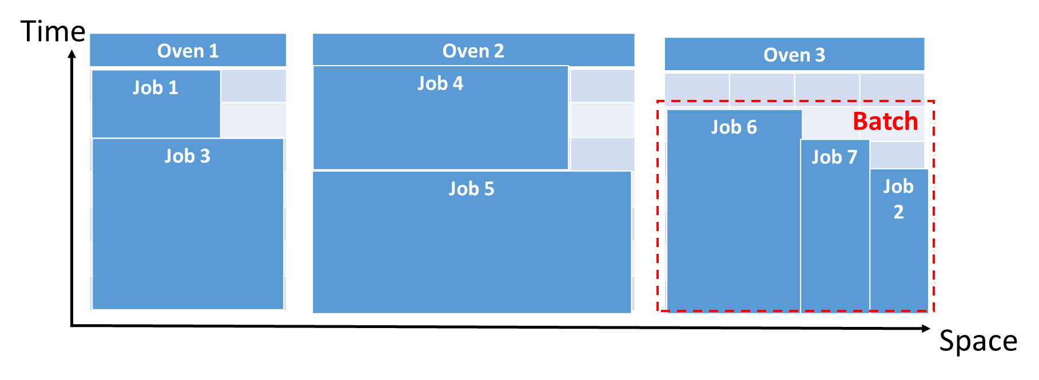
A problem solution
NumbOvens 3
NumJobs 7
OvenCapacity 3 5 4
TimeNecessaryforEachJob 2 4 5 3 4 6 5
SpaceOccupiedPerJob 2 1 3 4 5 2 1
VBA code:
Public Type SolutionData
makespan As Integer ' final solution value
makespanOven() As Integer ' completion time of each oven
solFeasible As Boolean ' true if solution feasible, false otherwise
assignments() As Integer 'for each oven and batch, list of jobs assigned
End Type

Slide 8
A problem solution
NumbOvens 3
NumJobs 7
OvenCapacity 3 5 4
TimeNecessaryforEachJob 2 4 5 3 4 6 5
SpaceOccupiedPerJob 2 1 3 4 5 2 1
Dim sol As SolutionData
sol.assignments(1, 1, 1) = 3 ’ in oven 1, for batch number 1, the first job is 3
sol.assignments(1, 2, 1) = 1 ‘ in oven 1, for batch number 2, the first job is 1
sol.assignments(2, 1, 1) = 5 ‘ in oven 2, for batch number 1, the first job is 5
sol.assignments(2, 2, 1) = 4 ‘ in oven 2, for batch number 2, the first job is 4
sol.assignments(3, 1, 1) = 6 ‘ in oven 3, for batch number 1, the first job is 6
sol.assignments(3, 1, 2) = 7 ‘ in oven 3, for batch number 1, the second job is 7
sol.assignments(3, 1, 3) = 2 ‘ in oven 3, for batch number 1, the third job is 2
For this solution, the makespan is 7, and the overall solution is feasible

Slide 9
Functions provided
Reading instances iteratively from text file;
Insert the instance data into the InputData data structure;
The data structure to represent a solution, and a function that initializes this to -1 values;
The function that verifies if a solution is feasible and verifies the correctness of the makespan computation;
A structure of the overall code requested for the coursework, such as:
  A constructive heuristic (this week and the next one);
  A local search heuristic (next week and the one after);
  A metaheuristic (last two weeks).

Slide 10
What is next?
Get familiar with:
  The problem definition and its objective (i.e., use numerical small examples);
  The data structures;
  The functions in the VBA code provided.
  I hope you will enjoy this project!

